Slide 1
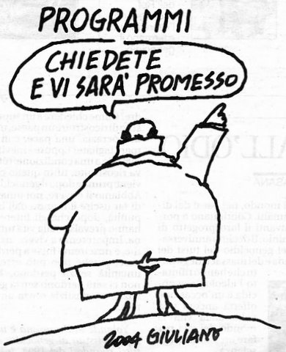
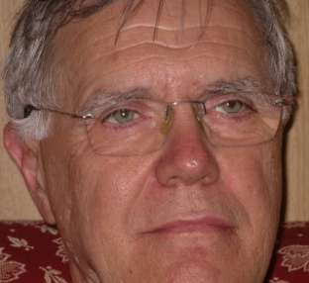
The rural development policy of the EU
Franco Sotte
(with the collaboration of Beatrice Camaioni)
Second part: the EU rural development policy in the period 2007-2013
PROGRAMS
ask and you
will be promised
Franco Sotte, vice-president of the Groupe de Bruges, is full professor of Agricultural Economics and Policy in the Faculty of Economics, Marche Polytechnic University, Ancona. (Italy). He is the scientific coordinator of this e-Learning course on the CAP.
www.sotte.it

Slide 2
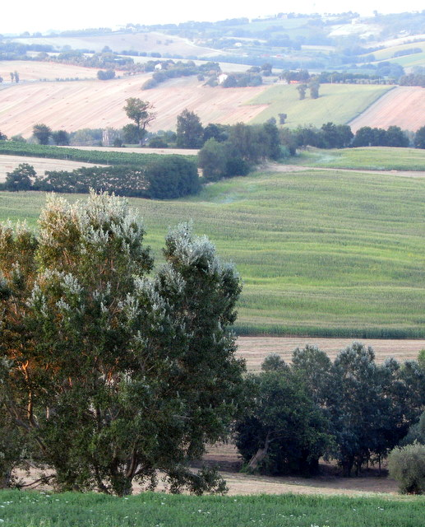
Rural development policy 2007-2013
Simplification
  One fund for Rural development policy
    European Agricultural Rural
    Development Fund (EARDF)
    One financial regulatory system
  One programming system
    Community Strategic Guidelines (CSG)
    National Strategy Plan (NSP)
    Rural Development Program/s (RDP)
  One evaluation and monitoring system
    Common Monitoring and Evaluation
    Framework (CMEF)
  One European Rural Development Network (ERDN)
For all the rural areas of the EU

Slide 3
Representation of the rural development policy in Europe
Rural Development 2007–2013
Axis 4 «Leader» (min 5%) – 3 meas
Axis 1
Competiti
veness
(min 10%)
16 meas
Axis 2
Environment
Land
Management
(min 25%)
13 meas
Axis 3
Econ. Diver.
Quality of
Life
(min 10%)
8 meas
Single set of programming, financing, monitoring, auditing rules
EARDF – European Agriculture and Rural Development Fund

Slide 4
The main measures of RD Policy 2007-2013
AXIS | MEASURE | EU-27
 |  | M€ | %
AXIS 1 | Competitiveness | 51,345 | 33.3
1.1 | Human resources: | 11,297 | 7.3
 | 1.1.2 Setting up of young farmers | 4,915 | 3.2
1.2 | Physical capital | 37,004 | 24.0
 | 1.2.1 Modernisation of agricultural holdings | 17,789 | 11.5
 | 1.2.3 Adding value to agricultural and forestry products | 9,089 | 5.9
 | 1.2.5 Infrastructure related to the development and adaptation of agriculture and forestry | 7,884 | 5.1
1.3 | Quality of agricultural production and products | 932 | 0.6
1.4 | Transitional measures | 2,113 | 1.4
AXIS 2 | Sustainability | 71,187 | 46.1
2.1 | Sustainable use of agricultural land | 63,107 | 40.9
 | 2.1.2 Payments to farmers in areas with handicap, other than mountain | 11,879 | 7.7
 | 2.1.4 Agri-environmental payments | 37,592 | 24.4
2.2 | Sustainable use of forestry land | 8,080 | 5,2
AXIS | MEASURE | EU-27
 |  | M€ | %
AXIS 3 | Diversification and quality of life | 18,837 | 12.2
3.1 | Diversification of the rural economy | 6,963 | 4.5
3.2 | Improvement of the quality of life in rural areas | 11,367 | 7.4
3.3 | Training, skills acquisition and animation | 252 | 0.2
3.4 | Implementation of local development strategies by public-private partnerships | 255 | 0.2
AXIS 4 | Leader approach | 9,281 | 6.0
4.1 | Implementation of local development strategies by Local Action Groups | 7,299 | 4.7
4.2 | Transnational and interterritorial cooperation | 459 | 0.3
4.3 | Local Action Groups | 1,522 | 1.0
5.1 Technical Assistance |  | 2,920 | 1.9
TOTAL |  | 154,378 | 100

Slide 5
The implementation process of the European Rural Development Policy
Reg. 1968/2005
Reg.1974/2006
Community
Strategic Guidelines
Cohesion
Policy
European Union
National Strategy
Plan
National Strategic
Framework
Member State
NO
Decentralized ?
YES
One
NRDP
RRDP
Region 1
RRDP
Region 2
[….]
RRDP
Region n
FR (1+5), PT (1+2),
FI (1+1)
UK (4)
BE (2), DE (14)
ES (17), IT (21)
IE, DK, SE, NL, LU, AT
GR, EE, LV, LT, PL, CZ, SK
HU, SI, RO, BG, CY, MT

Slide 6
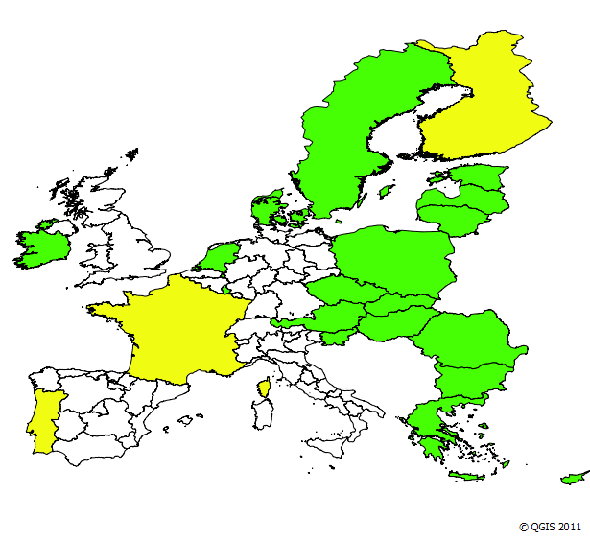
The territorial division of the EU in RDPs
88 RDPs
very different size in relation to
  different institutional systems of the MSs
    decentralization or centralization
  remarkable European rural diversity
    different latitudes
    land vocations
    climate conditions
    stage of development
    population density
1 RDP at MS level
1 National + specific RDPs
RDPs at regional level
Lȁnder
Home Nations
Comunidad autónomas
Regioni

Slide 7
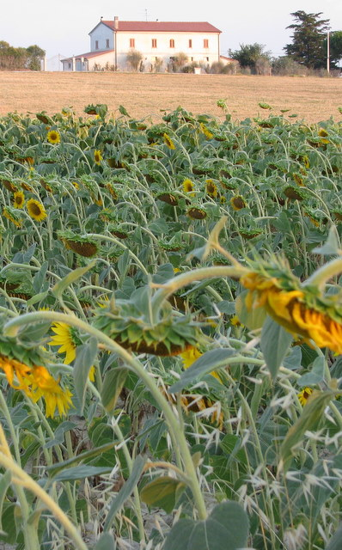
A multi-level governance
A very articulated structure
Based on a multi-level governance
  In accordance to the subsidiarity principle
  Integrating European, National and Regional institutions
  A place based and systemic approach
  Based on multi-annual programs
  Integrating top-down and bottom-up actions
  For better targeted and tailored measures
Quite different from the 1st pillar ones
  Where most of the decisions are centrally taken
  Support bypass the National and regional institutions
  The payments are roughly targeted and tailored

Slide 8
The reprogramming occurred in 2009
Three events
  3rd EU conference on rural development (Limassol, 16-17 Oct 2008)
  Health check of the CAP (20 Nov 2008)
  European Economic Recovery Plan (EERP) (11-12 Dec 2008)
New challenges
  Climate change
  Renewable energy
  Water management
  Bio-diversity
  Dairy restructuring
  Broadband
New funds: + 5,4%
An opportunity for adjustments

Slide 9
The weight of RDP within the CAP
Budget 2011 : appropriations for commitments
Million euro
Budget 2011 : unit values for
rural development policy
Variable | unit | Unit value
Agricultural employment | € | 1 298
Holding | € | 1 053
UAA | € | 84
Agric. Gross Value Added | % | 11,2

Slide 10
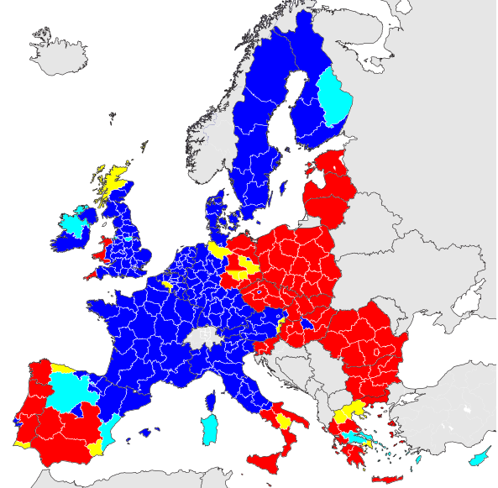
Convergence and competitiveness regions
Convergence Regions
Phasing-out Regions
Phasing-in Regions
Competitiveness Regions
 | Regime | Condition 1 | Condition 2
Convergence | Normal | Gdp/In_{reg} < 0,75 Gdp/In_{ue-27}
 | Phasing out | Gdp/In_{REG} > 0,75 Gdp/In_{UE-27} | Gdp/In_{REG} < 0,75 Gdp/In_{UE-15}
Compet. and employment | Normal | Gdp/In_{REG} > 0,75 Gdp/In_{UE-27} | Gdp/In_{REG} > 0,75 Gdp/In_{UE-15}
 | Phasing in | Gdp/In_{REG} > 0,75 Gdp/In_{UE-27} | Agenda 2000 Gdp/In_{REG} < 0,75 Gdp/In_{UE-15}

Slide 11
The allocation of RD funds
Aggregate of MSs | 2007-13 Total FEASR |  | RDP/AWU per year |  | RDP/UAA per year |  | RDP/Val Add per year
 | M€ | % | € | Index | € | Index | % | Index
EU-15 | 105,845 | 69 | 121 | 95 | 2,666 | 141 | 17.2 | 81
- North | 23,948 | 16 | 121 | 94 | 5,012 | 266 | 42.6 | 200
- Center | 37,875 | 25 | 106 | 83 | 2,987 | 158 | 14.3 | 67
- South | 44,022 | 29 | 139 | 109 | 1,980 | 105 | 15.0 | 70
EU-12 | 48,533 | 31 | 145 | 113 | 1,151 | 61 | 43.9 | 206
EU-27 | 154,378 | 100 | 128 | 100 | 1,886 | 100 | 21.3 | 100
Large part of RDP funds to the CEECs and Southern Europe
  where most of the convergence regions are concentrated
  Rebalancing (partly) the skewed distribution of Pillar 1

Slide 12
Unit values of RD policy per MS
EARDF + Co-financing 2007-2013, euro per Annual Working Unit (AWU) and per Utilized Agricultural Area (UAA)
MSs | RDP/UAA | RDP/AWU
 | €/ha /year | €/Awu/year
FI | 425 | 13470
SE | 185 | 8819
AT | 360 | 7021
LU | 429 | 14974
MT | 1405 | 3440

Slide 13
The distribution between Axes

Slide 14
A more detailed vision on the distribution of funds at EU level

Slide 15
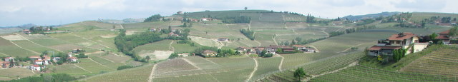
The two pillars at Member State level
Average % - years 2007-2008-2009

Slide 16
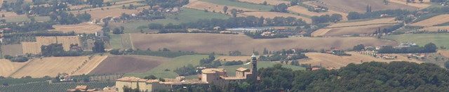
The execution of the budget
Billion euro
 | Budget 2008 |  | Budget 2009
 | Appr Comm | Appr Pay | Appr Comm | Appr Pay
CAP Pillar 1 | 40,562 | 40,568 | 40,781 | 40,781
CAP Pillar 2 | 13,303 | 11,383 | 13,652 | 10,229
CAP total | 53,865 | 51,951 | 54,433 | 51,010
Total EU Budget | 130,363 | 115,565 | 133,637 | 115,887
P2/P1=1:3
P2/P1=1:4

Slide 17
The final payments
Financial report 2009
 | Pillar 1 | Pillar 2 | CAP Total | Pil 1 / CAP | Pil 2 / CAP
 | M€ | M€ | M€ | % | %
EU-15 | 36,563 | 5,241 | 41,804 | 87.5 | 12.5
North-15 | 6,295 | 1,041 | 7,336 | 85.8 | 14.2
Center-15 | 16,447 | 2,394 | 18,841 | 87.3 | 12.7
South-15 | 13,821 | 1,806 | 15,627 | 88.4 | 11.6
UE-12 | 4,468 | 3,498 | 7,966 | 56.1 | 43.9
UE-27 | 41,031 | 8,739 | 49,770 | 82.4 | 17.6
Outside MSs | 5,062 | 0 | 5,063 | 100. | 0
Total EU | 46,093 | 8,740 | 54,833 | 84.1 | 15.9
P2/P1=1:7
P2/P1=1:8
P2/P1=3:4
P2/P1=1:5

Slide 18
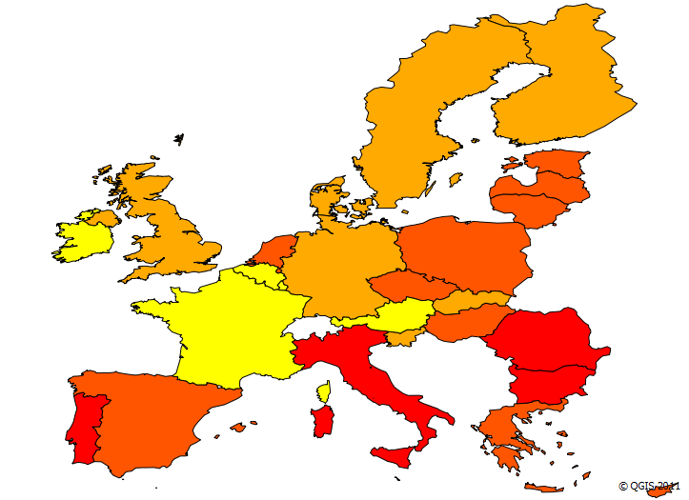
The execution of the RD Policy
EAFRD funds
Aggregates of Member States | Budget 2007-2009 | Expenditure 2007-2009 | Expenditure /Budget 2007-09 | Expenditure /RDP 2007-2013
 | M€ | M€ | % | %
Eu-15 | 22,627 | 13,744 | 61 | 23
- North | 4,651 | 3,510 | 75 | 30
- Center | 8,632 | 6,573 | 76 | 30
- South | 9,344 | 3,661 | 39 | 15
Eu-12 | 15,244 | 5,987 | 39 | 16
Eu-27 | 37,870 | 19,731 | 52 | 21
52% of funds transformed in actual payments in 3 years
Executed 21% of the available budget for 2007-2013
  Northern and Central EU-15 a physiological rate of execution
  Delays in Eastern (esp. Ro, Bg) and Southern MSs (esp. Pt, It)
Expenditure/Budget 2007-09
15-37%
37-59%
59-80%
80-103%

Slide 19
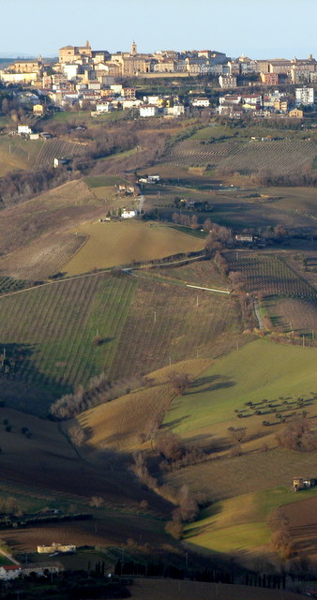
Strengths of the RD Policy 2007-2013
A remarkable effort
  Quality of the analysis, solutions found to RD, new forms of selection, integrated measures
An implementation of the practice of evaluation
  From an “in phase” approach to a “continuous cycle”
Networks and transparency
  Transparency, dialogue, common interests
An experience of participation
  A community of practices set to expand and strengthen

Slide 20
Weakness of the RD Policy 2007-2013
Times too extended
  Delays concentrated in the convergence regions
Gap between the analysis and the concrete measures adopted
  No clear priority, weak selectivity
Time priority reverse
  The easiest measures first
  The most innovative delayed
Lack of integration between
sectoral and territorial policy
  Axes 3 & 4 a marginal role
  Axes 1 & 2 a separate design
  and an independent
  management scheme
Sectorial policy
Terri
torial
policy
Total 82%
Axis 4
6%
Axis 1
Competiti
veness
33%
Axis 2
Environment
Land Mngt
46%
Axis 3
Econ.Div.
Quality
of Life
12%
Single set of programming, financing, monitoring, auditing rules
EARDF – European Agriculture and Rural Development Fund

Slide 21
Conclusive remarks
The merits of Pillar 2 (compared to Pillar 1)
  more consistent with long-term objectives of the EU
  more comprehensive and strategic
  more integrated with the other EU policies
Nevertheless Pillar 2 plays in the CAP a secondary role
  Pillar 1 : a solid pillar, Pillar 2 : a slender column
  Debate monopolized by Pillar 1 (single farm payments)
Future of Pillar 2 ?
  Some shifts to P1 : green payments, support to LFAs
  Some new entry in P2 : risk management
  Still difficult to indentify a coherent and comprehensive strategy

