Slide 1
The EU rural development policy
Franco Sotte
(with the collaboration of Beatrice Camaioni)
First part: the history of the EU rural development policy
Franco Sotte is full professor of Agricultural Economics and Policy in the Faculty of Economics, Marche Polytechnic University, Ancona. (Italy). He is vice-president of the Groupe de Bruges, and scientific coordinator of this e-Learning course on the CAP.
www.sotte.it

Slide 2
Contents
The sectorial approach of the original CAP
The origins of rural development policy in the EU
The cohesion policy and the MacSharry reform
The LEADER Experience
The 1st Conference on RD and the 2nd pillar in Agenda 2000
The 2nd Conference on RD and the Fischler reform
Franco Sotte

Slide 3
The origins of the EU Rural development policy
The "original sin“ of the EU rural development policy
RDP is not the result of a general reflection on development issues and their specific configuration in rural areas
It is the consequence of the crisis of a sectorial policy, the CAP, whose original justifications have been weakened over time, while new expectations and new demands have emerged
A difficult challenge: integrating the only sectorial traditional CAP into a new sectorial and territorial policy is a tricky task, because over time a strong conservative lobby has grown in defense of the traditional CAP measures
But also an opportunity: the CAP carries a substantial budget, which is obviously key resource for rural development policy as it would be extremely difficult to establish from scratch
There is therefore a complex transformation to be managed
To combine the sectorial agricultural objectives with the more general territorial ones
To integrate the CAP in the overall strategy of cohesion and balanced development of the EU (Lisbon and Gothenburg objectives)
Franco Sotte

Slide 4
The old CAP between Guidance and Guarantee
Aimed at sectorial concerns => agricultural policy
Concentration on market policies (90-95% of expenditure)
So-called policies of "guarantee"
Each product a Common Market Organization (CMO)
Main objective: price support
Little effort and funds for structural policies (5-10%)
So-called policies of "guidance"
Main objective: agricultural restructuring => maximum efficiency
1962: The European Agricultural Guidance and Guarantee Fund (EAGGF) was founded
two sections: Guarantee and Guidance
Territorial issues and rural development are not in the old CAP
Franco Sotte

Slide 5
Pros and cons of the old CAP
Pros
Sectorial: Ensuring food security
General: the CAP as a crucial pillar of the European foundation
Cons
It costs too much: CAP spending in 1985 = 73% EU budget
It produces surpluses in almost all products
It benefits the richest and most favored regions
It is a centralized policy
It does not bond with other EU policies
Social Fund (ESF) since 1960
Objective: Employment
European Regional Development Fund (ERDF) since 1975
Objective: Regional Development
Franco Sotte

Slide 6
The origins of the EU rural development policy
Sectorial reasons
The need
to reform the CAP
to coordinate it with the other EU policies
General reasons
Reinforced engagement for the structural and cohesion policy
In the perspective of further enlargement it would became fundamental
Recognition of the role of the Regions (and other Local Institutions)
Franco Sotte

Slide 7
Single European Act 1986 and Maastricht Treaty 1991
Establishment of the “European Union” and the “European Community”
Added Title XVII, "Economic and social cohesion" to the Treaty of European Community
Art 158
"to promote its overall harmonious development, the Community shall develop and pursue its actions leading to the strengthening of its economic and social cohesion. In particular, the Community shall aim at reducing disparities between the levels of development of the various regions and the backwardness of the least favoured regions or islands, including rural areas"
Art 161
Set up the Cohesion Fund
Art 263
Established the Committee of Regions
Franco Sotte

Slide 8
The reform of structural policies of 1988
Reg 2052/1988: reform of the Structural Funds
Financial Perspectives 1988-1992
Milestones
Subsidiarity (matters handled by the smallest, lowest or least centralized competent authority)
Partnership
Co-financing
Programming by objectives
Objective 1: regions lagging behind
Objective 2: areas in industrial decline
...
Ob.5-a: Agricultural Structural Adjustment
Ob.5-b. Rural development
Joint action of all funds (EAGGF, ERDF, ESF, EIB)
Monitoring and evaluation
Franco Sotte

Slide 9
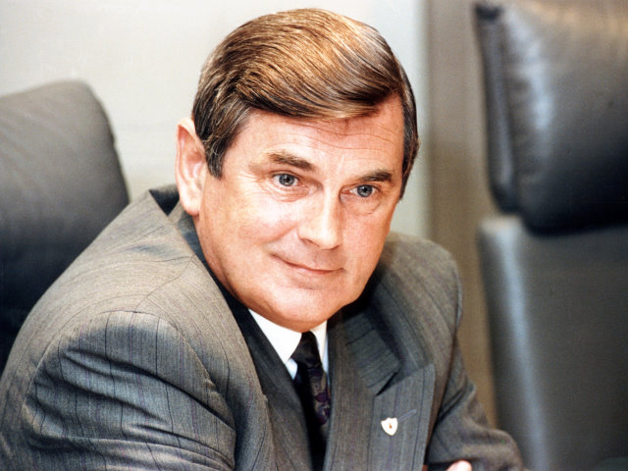
The MacSharry reform of 1992
Market support
Lower price support
with the aim of bringing domestic prices closer to world ones
Introduction of compensatory payments
partial decoupling
But ...
Accompanying measures (co-financed by the Member States)
Reg.2078/1992 Agro-environmental measures
Reducing fertilizer
Extensification
Organic farming
Eco-friendly methods
Care of abandoned land
Set-aside 20 years
et al
Reg.2079/1992 Early-retirement
Reg.2080/1992 Forestry
Franco Sotte

Slide 10
The Community Initiative LEADER
The Community Initiatives are EU innovative programs
"LEADER" = Liaison Entre Actions de Développement Rural
Leader 1: 1991-93, Leader 2: 1994-99, Leader +: 2000-2006
LEADER peculiarities
A defined rural area
A Local Action Group (LAG) between subjects and institutions both public and private
A Local Development Programme (LDP)
The main features of a LDP
Demonstrative initiatives of Rural Development
Public / Private partnerships
Innovative solutions
Synergies between economic sectors
Repeatable practices (possibly shared with other LAGs)
Co-operation between rural areas in different countries
Results
893 LAG in Europe
A positive assessment
Franco Sotte

Slide 11
The situation in the mid-90s
Still evident: a deep gap between the CAP and all other EU policies
The EU has opened a broad debate in the mid-nineties
international conflicts under the WTO aimed at abolishing the agricultural protectionism and fostering market liberalization
Next EU enlargement to countries lagging behind (cohesion)
Buckwell Report
transition from CAP to CARPE (Common Agricultural and Rural Policy for Europe)
combining sectorial issues with territorial ones in a rural development policy
Franco Sotte

Slide 12
1st Conference on Rural Development Cork - November 1996
THE CORK DECLARATION
1. Rural preference: rural development a priority
2. Integrated approach: multidisciplinary and multisectoral policy
3. Diversification: economic and social
4. Sustainability: integrate short-long term, responsibility to link local-global
5. Subsidiarity: decentralization and bottom-up approach
6. Simplification: of the rules, flexibility, decentralization
7. Programming: a rural development program in each MS/region
8. Finance: synergy between public and private funds
9. Management: networks, communications, exchange of experience, partnership
10. Evaluation and Research: monitoring, transparency, participation
Franco Sotte

Slide 13
The failure of the Cork conference
The three “Cork Fears”
Farmers against other rural categories
“The CAP funds to the hairdressers ..."
Clash between Member States
the opposing French and German positions
Institutional Clash
DG-Agri versus DG-Regio
Consequences
Cork: a "non-event“
Debasement of commitment to Rural Development
Vivification and postponement of a substantial reform of the CAP
Franco Sotte

Slide 14
Agenda 2000
The CAP reorganized around two pillars
Pillar 1 - Market policy and direct payments (90% expenditure)
Pillar 2 - Rural development policy (only 10% of expenditure)
What does the 2nd Pillar comprise?
Long list of measures
In addition to the old structural measures: setting up of young farmers, early retirement, training, support to less favored areas, processing and marketing, agri-environmental aid, forestry, modernization of rural areas
In short, three directions
Structural improvement
Agri-environment
Diversification and quality of life
Each Member State (Region) defines a Rural Development Program (integrated in the Regional Operational Program in the lagging regions)
National and regional Co-financing
Franco Sotte

Slide 15
The Fischler reform from the point of view of rural development
Mid-term review and Fischler reform
Agenda 2000: a disappointing compromise
Mid-term review programmed in 2002
The Fischler reform (June 2003)
More reform content in the Mid Term Review than in Agenda 2000
The main novelty
Decoupling and Single Farm Payment (SFP)
Mandatory cross-compliance
New additional measures added in Pillar 2
Adaptation to standards and compliance with EU regulations
Animal welfare
Food quality
Modulation (phased funds transfer from 1st to 2nd Pillar)
20% in the Fischler's original proposal, reduced to only 5% in the final agreement
Result: the expenditure of 2nd / 1st Pillar still 20% / 80%
Franco Sotte

Slide 16
2nd Conference on Rural Development Salzburg November 2003
The final statement
Rural development: a matter for everybody
Agriculture plays a vital role
Diversification and multifunctionality
Rural Development Policy for all of EU rural areas
It must contribute to the economic and social cohesion
It must be based on public-private cooperation and local partnerships
Bottom-up approach: mainstreaming the LEADER experience
Creating networks and exchange best practices
The advantages and limitations of Salzburg 2003 compared to Cork 1996
Agreement between DG Agri and DG Regio: less courage compared to Cork, but more realism
A more "agricultural" approach to rural development?
The word “agricultural" or “agriculture" appears 11 times in the Salzburg statement versus twice in that of Cork
Franco Sotte

